Slide 1
Transferability vs. Discriminability
Chen, Xinyang, et al. "Transferability vs. discriminability: Batch spectral penalization for adversarial domain adaptation." International Conference on Machine Learning. 2019. (School of Software, BNRist, Research Center for Big Data, Tsinghua University.
魏煜华
2020.11.24

Slide 2
Problems
While adversarial learning strengthens the feature transferability, which part of the features are transferable remains unclear.
How the feature discriminability will change in the process of learning transferable features has not been fully explored.
Experiments revealing a deterioration of the discriminability while learning transferable features adversarially.

Slide 3
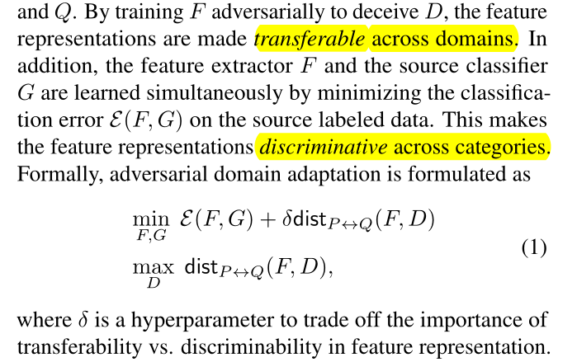
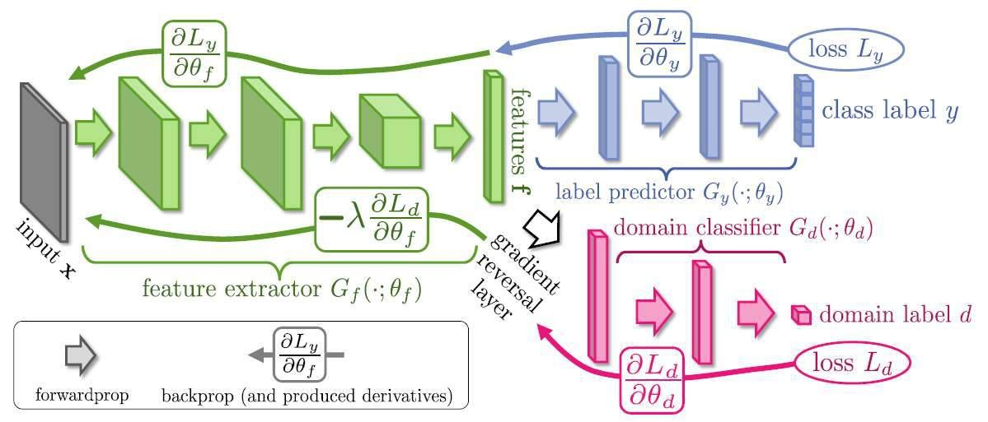
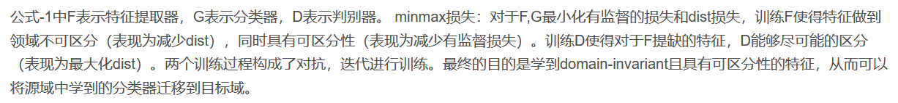
Adversarial Domain Adaptation

Slide 4
Transferability vs. Discriminability
There are two key criteria that characterize the goodness of feature representations to enable domain adaptation
Transferability, which indicates the ability of feature representations to bridge the discrepancy across domains.
Discriminability, which refers to the easiness of separating different categories by a supervised classifier trained over the feature representations.
Adversarial domain adaptation methods make remarkable advances in enhancing the transferability of representations, however, the discriminability of the learned representations has only been attempted via minimizing the classification error on the source domain labeled data.
This vanilla strategy is not good enough!!!

Slide 5
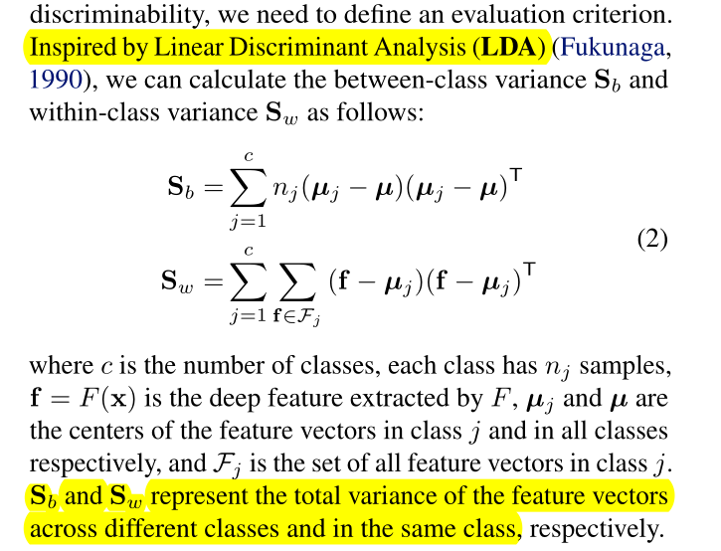
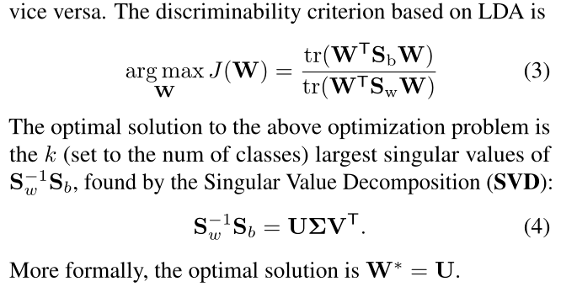
Discriminability of Feature Representations
An evaluation criterion inspired by LDA
project the high-dimensional feature vectors into lowdimensional space and calculate the ratio of between-class variance to within-class variance.
larger ratio imply stronger discriminability and vice versa.

Slide 6
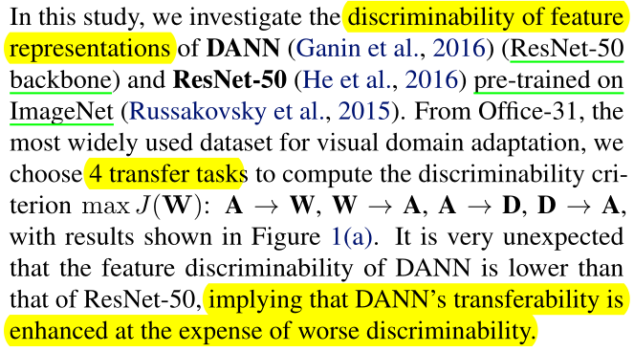
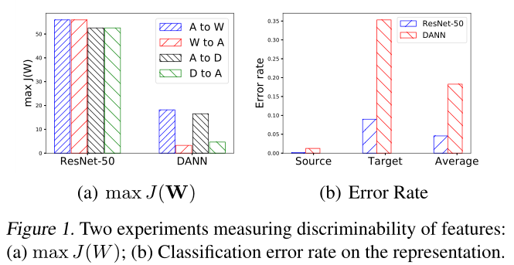
Discriminability of Feature Representations
DANN提取的特征的 max ⁡ J ( w ) 值相比ResNet-50都很小，说明DANN提取的特征的可区分性更差，即迁移是以牺牲可区分性为代价的。

Slide 7
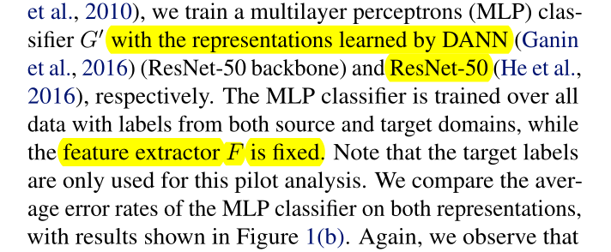
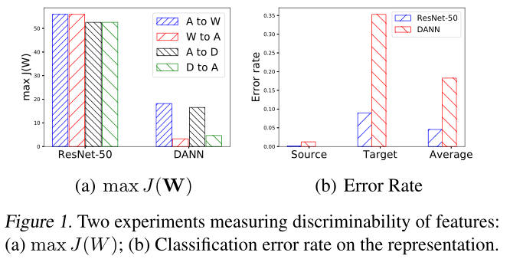
Discriminability of Feature Representations
Why features extracted by DANN present worse discriminability?
为什么DANN提取到的特征可区分性差呢？
(b) How can we enhance the transferability while guaranteeing acceptable discriminability? 我们如何在加强迁移性能的同时保证可区分性呢？

Slide 8
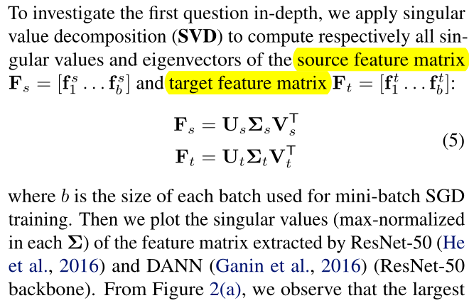
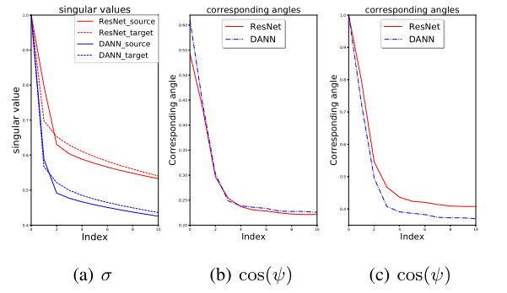
Why Worse Discriminability?
Intuitively, the feature transferability may mainly reside in the eigenvectors with top singular values, since the eigenvectors with low singular values may embody domain variations and should be discouraged. (直观地，特征可传递性可能主要存在于具有最高奇异值的特征向量中，因为具有低奇异值的特征向量可能体现domain variations，应该被discourage.
Notes:
首先考虑第一个问题。使用奇异值分解（SVD）分别得到源域特征和目标域特征的奇异值和对应的特征向量。
从图中可以看出，DANN提取的特征矩阵的最大的奇异值比其它的大很多，曲线下降迅速；而ResNet的曲线平缓很多。 于是可得这种奇异值过大的差异性表征了差的可区分性。(PS. 这里作者考虑了PCA和SVD的奇异值和特征向量的含义，最大的奇异值代表最主要的成分，所以在做domain adaptation时，我们是希望源域和目标域两者的最主要成分相近，然而分类情况是复杂的，它不仅仅依赖于这个最大的奇异值，而是依赖于多个奇异值，但是从图2-(a)中可以明显的看到，domain adaptation对其它较小的奇异值做了过度的“惩罚”，由此影响了可区分性。然而作者的这种假设或者说这种对应关系是否成立呢？对于不同的网络，不同的迁移任务下都是这样吗？)

Slide 9
Approach
Transferability and discriminability are equally important for learning good representations in adversarial domain adaptation.
How to enhance transferability while guaranteeing acceptable discriminability?
Two-fold:
The eigenvectors corresponding to larger singular values should be fully leveraged to enhance transferability.
较大的奇异值对应的特征向量对于迁移性更具有代表性，充分利用这点增强迁移性；
The eigenvectors corresponding to relatively smaller singular values should also be leveraged to convey richer structures, which are vitally important for discriminability.
相对较小的奇异值对应的特征向量对于可区分性是十分重要的，充分利用这点增强可区分性。
Notes:
首先，应该充分利用对应于较大奇异值的特征向量来增强可转移性，因为这些特征向量通常抑制域变化。
其次，与相对较小的奇异值相对应的特征向量也应该被利用来传达更丰富的结构，这对于辨别是至关重要的。

Slide 10
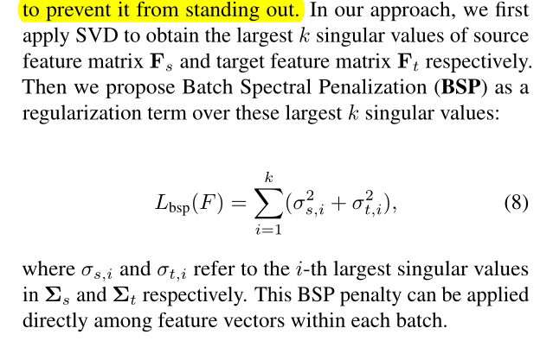
Batch Spectral Penalization
首先对源域特征矩阵​和目标域特征矩阵使用SVD,得到k个最大的奇异值；
提出Batch Spectral Penalization (BSP)这个正则项对这k个最大的奇异值做惩罚：

Slide 11
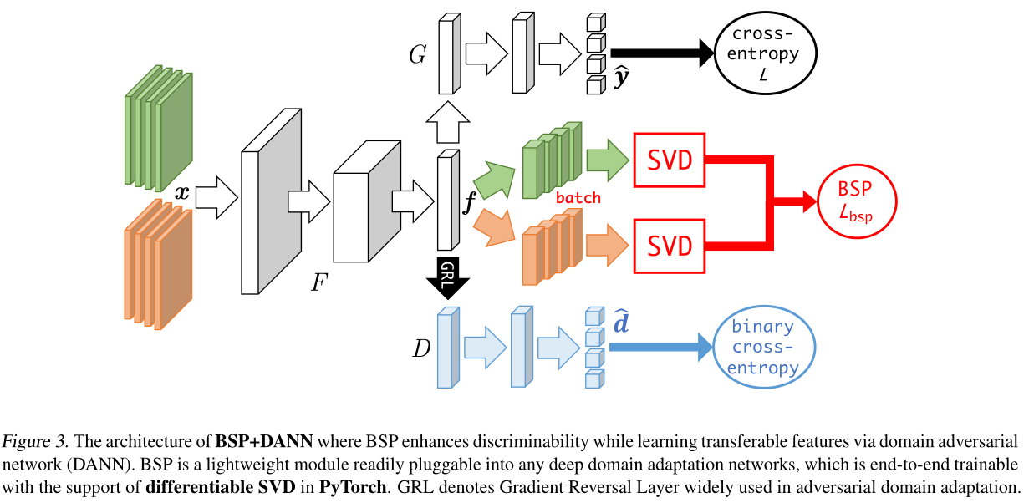
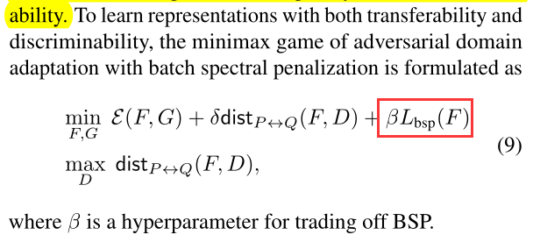
Models with Batch Spectral Penalization

Slide 12
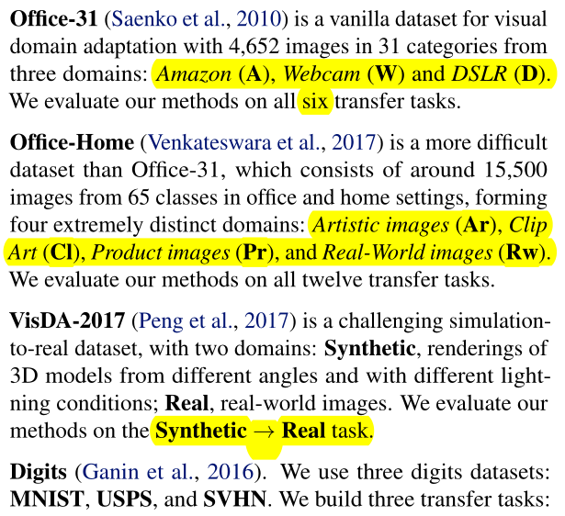
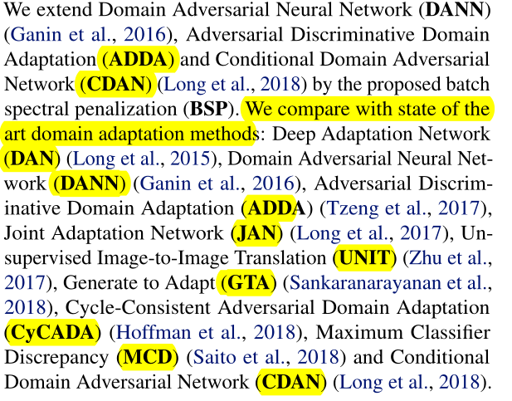
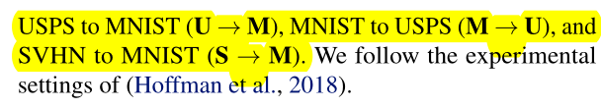
Experiments
Setup

Slide 13
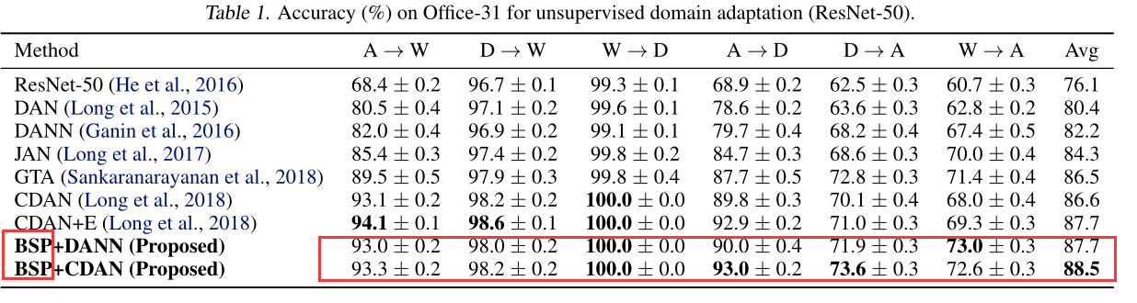
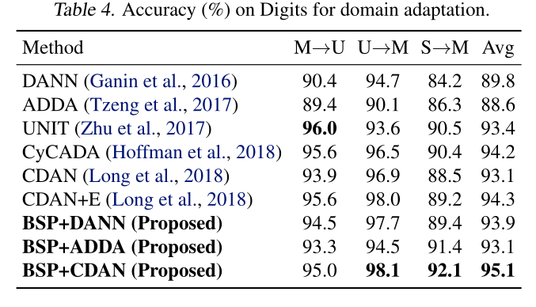
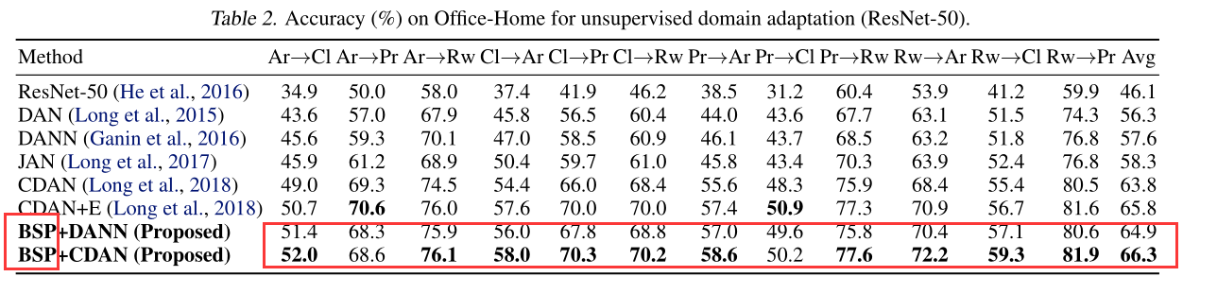
Experiments
Results
On office-31, our method significantly improves the performance of domain adversarial networks and achieves state of the art results.

Slide 14
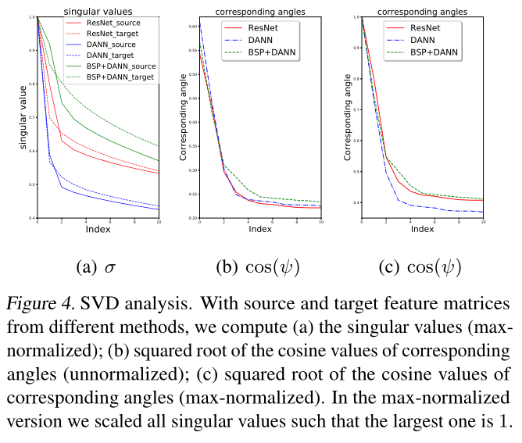
Analysis

Slide 15
Conclusion
Investigate how to learn feature representations that are both transferable and discriminative for deep domain adaptation.
Previous works mainly focus on the transferability, we find that existing adversarial domain adaptation methods may inevitably deteriorate the discriminability.
Propose a regularization approach based on spectral analysis of the feature representations, which is general and pluggable into any adversarial domain adaptation networks to yield significant performance gains.

